Slide 1
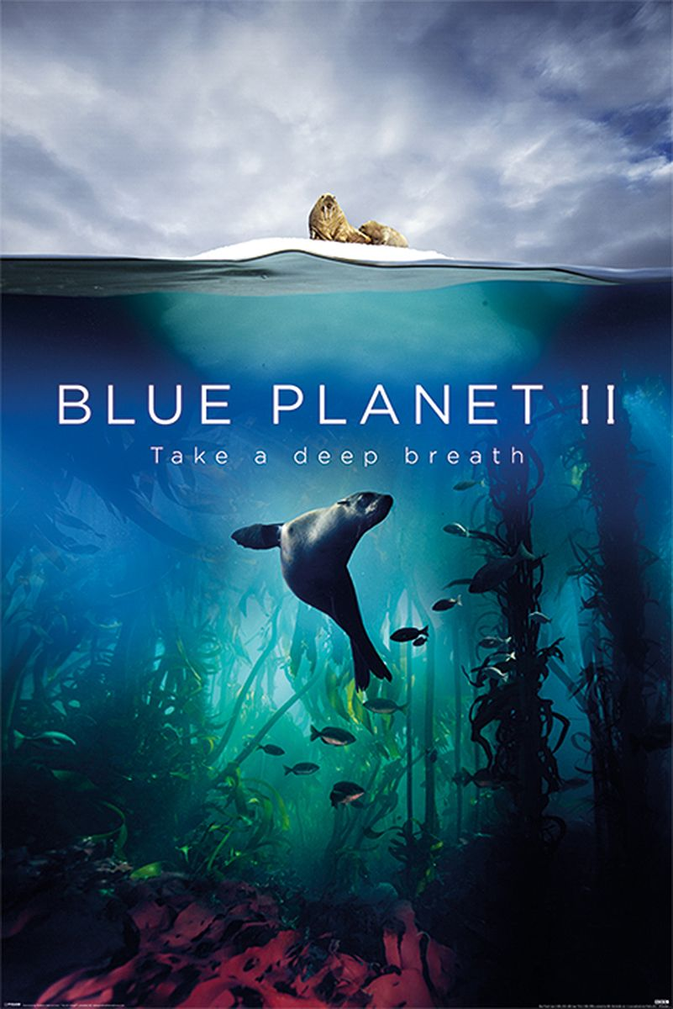
To watch:
Human: The world within – Netflix
Our planet – Netflix
Blue Planet
Youtube: Web of complex biology: Bill Nye
Youtube: National geographic
To read:
Michael Crichton – Jurassic Park
99% Ape – Jonathan W Silvertown
Biology
To visit:
Thinktank Birmingham: watch what you can do
National History museum walk through
Charles Darwin’s home
RSPB centres
Canal and river trusts
Chester Zoo, Wild Place (Bristol), Sea Life Centres

