Slide 1
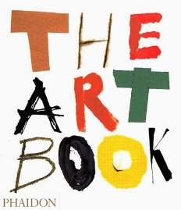
What can I read? 📚
The Art of Creative Thinking by Rod Judkins
Why is Art full of Naked People? by Susie Hodge
The Art Book: Phaidon
Artmag
What can I listen to? 🎧
Who Arted? Weekly Art History for all ages
Arts & Ideas BBC Radio 3
Jo’s Art History Podcast
FREE Art Apps!
Daily Art, Google Arts & Culture, Smartify: Museums & Art Guide
What can I watch? 💻
Exit Through the Gift Shop: This is a tale of Banksy and other street artists
Rivers and Tides: This film chronicles the work of landscape sculptor Andy Goldsworthy.
Between the Folds: This fascinating documentary shows the incredible things artists can do with paper.
Cave of Forgotten Dreams: Go inside the Chauvet caves in France to experience some of the world’s earliest art.
Made You Look – A true story about fake art (Netflix)
Art History School (Youtube channel)
Where can I visit? 🚶
Wolverhampton Art Gallery
Worcester City Art Gallery and Museum
Birmingham Museum and Art Gallery
Pitt Rivers Museum, Oxford
The National Galley London (online virtual tour)

