Slide 1
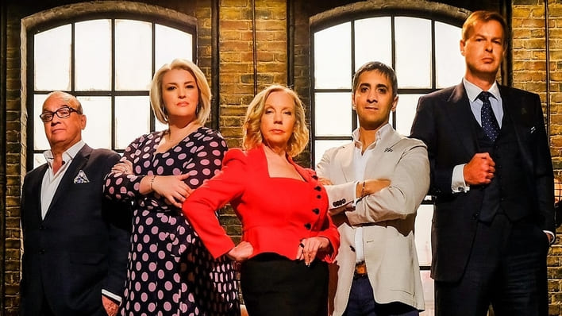
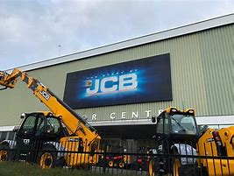
Business
What can I read?
Inspiration by Elon Musk
Screw It, Let’s Do It: Lessons In Life by Richard Branson.
Start It Up: The Complete Teen Business Guide to Turning Your Passions Into Pay by Kenrya Rankin.
What you see is what you get by Alan Sugar.
Where can I visit?
Cadbury World Walk and Tour
Alton Towers Resort
JCB Factory Tour
Drayton Manor Park
The Silverstone Experience
What can I watch?
The Apprentice BBC
Dragon’s Den BBC
Inside Bill’s Brain: Decoding Bill Gates
Planet of the Apps Apple Music
Shark Tank Netflix

