Slide 1
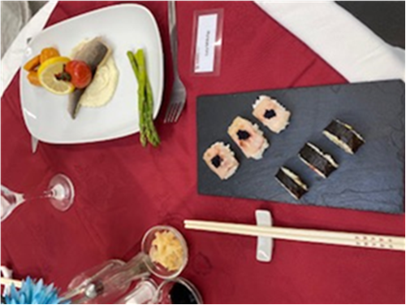
Catering
What can I read?
The Good Food Magazine
Baking Bible: Mary Berry
One Pot Wonders: The Hairy Bikers
Complete Children's Cookbook: DK books
Time to Eat: Nadia Hussain
What can I watch?
Foodnetwork: Freeview channel 43. continuous cooking programmes from around the world.
MasterChef: Greg Wallace and John Torode
Where can I visit?
The Good Food Website: Full of fantastic, simple and cost effective recipes for all tastes: www.goodfood.com
Youtube: Watch episodes of your favourite chefs or search for experiments and demonstrations – this the link for the YR8 raising agent module - https://www.youtube.com/watch?v=0USi4DbRVVQ

