Slide 1
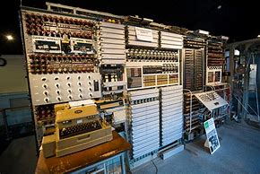
Computer science
What can I read?
A Day in code Python: Shari Eskenas
Computational Fairytales: Jeremy Kubica
Ready Player One: Earnest Cline
Gamer Army: Trent Reedy
Hello World!: Warren Sande
What can I watch?
History of computer Science - History of Computer Science for Kids - YouTube
Python coding: "Python for kids" course, chapter 1. Full course you can find at Udemy!
The Internet of everything: The Internet of Everything - Top Documentary Films
Battlefield 3 simulator: Ultimate Battlefield 3 Simulator The Gadget Show - YouTube
Where can I visit?
Bletchley Park – Bletchley Park - Virtual Tour (codesandciphers.org.uk)
The National Museum of Computing - 3D Virtual Tour — The National Museum of Computing (tnmoc.org)
Appleworld - AppleMuseum 3D virtual tour (applemuseum360.com)

