Slide 1
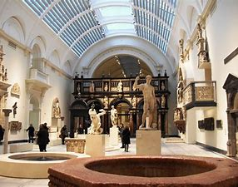
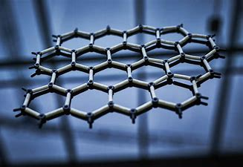
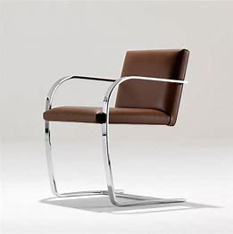
Design Technology
What can I read?
The design of every Things: Donald Norman
Logo Design Love: David Airey
Organic deign in home furnishings: Eliot Noyes
Cradle to cradle: Remaking the way we make things: William McDonough
The Genius of Design: Penny Sparke
Where can I visit?
The Design Museum - Virtual Tour of Museum (free) - https://designmuseum.org/venue-hire-old/virtual-tour-of-the-design-museum#
The V & A museum virtual tour- An Introduction to the V&A – YouTube
Mechanical toy Museum- Home - The Mechanical Art & Design Museum (themadmuseum.co.uk)
What can I watch?
Abstract: The art of design, Netflix
Biomimicry: Biomimicry is more than just good design. – YouTube
Principles of good design: Ask a Designer: Dieter Rams' 10 principles of good design – YouTube
New materials: Amazing New Materials That Are On Another Level - YouTube

