Slide 1
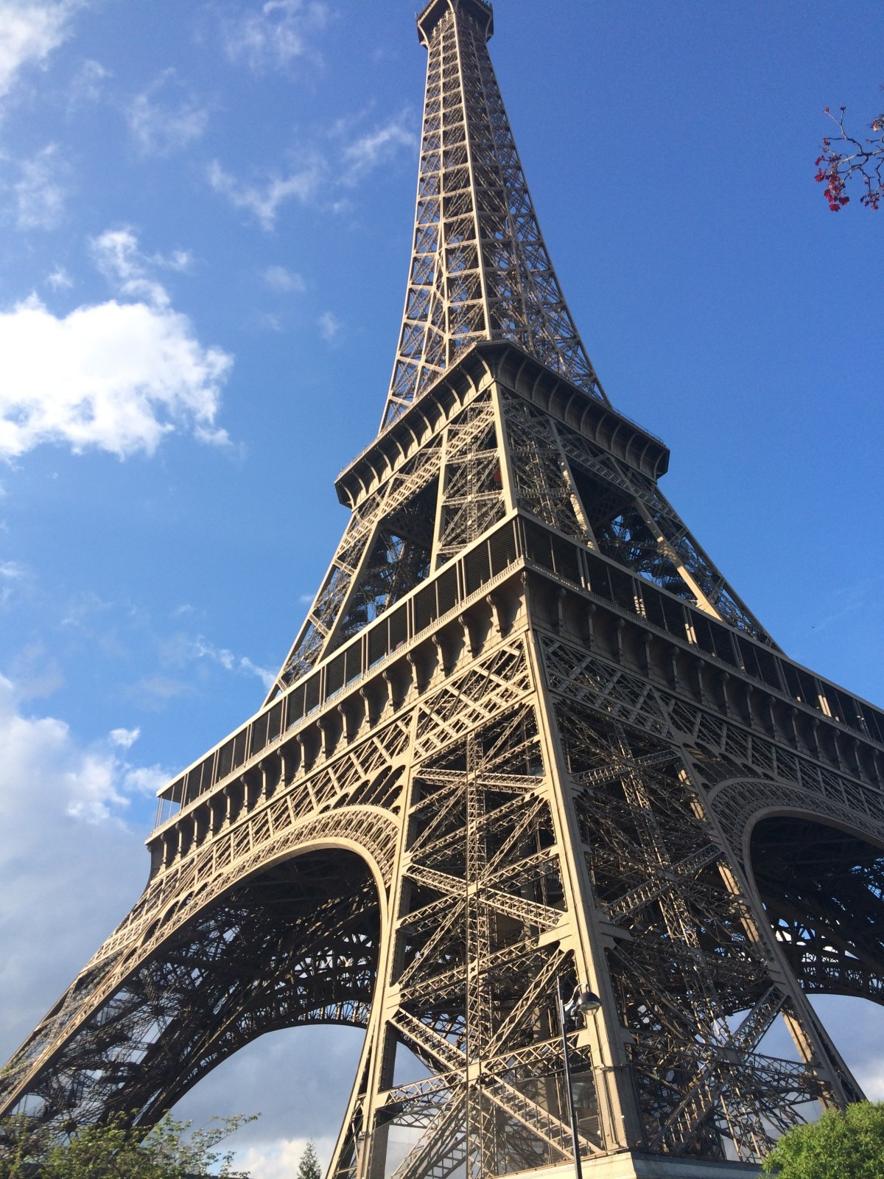
French
What can I read?
Le petit prince by Antoine de Saint-Exupéry.
Tin Tin by Hervé.
Asterix by René Goscinny.
Le petit Nicolas by René Goscinny.
What can I watch or listen to ?
- Netflix – change any film into French ( change the language settings).
- Listen to ‘ Coffee break French’ Podcasts.
- Lupin (aged 15 ) Watch Lupin | Netflix Official Site
- Listen to French radio./ music.
Where can I visit?
The theatre to watch French
films Film Programme 2022-23 (malvernfrenchfilmcentre.uk)
- Institut français du Royaume-Uni | French Cultural Institute in South Kensington
(institut-francais.org.uk)

