Slide 1
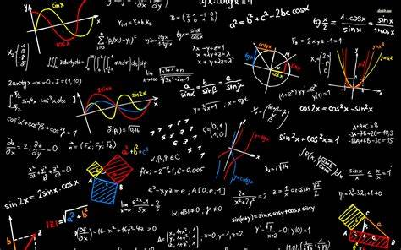
MATHEMATICS
What can I read? 📚
Humble Pie: A Comedy of Maths Errors by Matt Parker
Weird Maths: The Edge of Infinity and Beyond by David Darling &Agnijo Banerjee
Alex's Adventures in Numberland: Dispatches from the Wonderful World of Mathematics by Alex Bellos
What can I listen to? 🎧
BBC Learning Maths Challenge Podcast
Mathdude Podcast
The Numberphile Podcast
FREE Maths Apps!
Times Tables Rock Stars
King of Maths
Math Riddle IQ Test
Where can I visit? 🚶
Techniquest Science Discovery Centre
Bletchley Park
Greenwich Museum
National Space Centre
What can I watch? 💻
Numberphile Numberphile - YouTube
Mathantics mathantics – YouTube
Royal Institution Lectures Browse our science online | Royal Institution (rigb.org)

