Slide 1
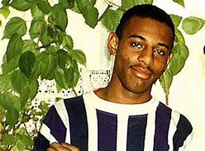
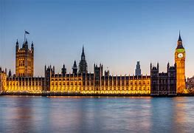
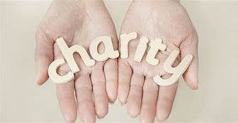
Citizenship
What can I read?
Home - BBC News
HOW DOES THIS POLITICS THING WORK THEN? - Home (politicsforkids.co.uk)
I am Malala- A book about one girl standing up for her rights and education. An example of active citizenship.
You are a champion- By Marcus Rashford. A book on how to use your voice to help others and be the best you can be.
What can I watch?
Watch the news! Don’t be tempted to stick to just one channel either- ensure you listen to different news stations e.g. BBC, ITV, Channel 4, Sky and see if you notice any differences in the ways they report the news. Do they show bias?
Suitable for Y7+
Stephen Lawrence: the murder that changed a nation. This is a programme about the racially fuelled attack on Stephen Lawrence. Suitable for Y9+
Do Black Lives Still Matter? A programme that explores the impact of the Black Lives Matter movement. Are lives any better for people of colour?
Suitable for Y10+
Where can I visit?
The Houses of Parliament are a great place to visit if you get a chance. If you can’t go in person, you can have a look inside here.
Do you like shopping? Visit your local charity shop and see if you can volunteer your time or find a bargain! This is a great way to become an active citizen and get involved in the community!
Do you have experience in a particular sport or extra curricular activity? See if you can help at your local Rainbows group or lend a hand at your local sport’s team.

