Slide 1
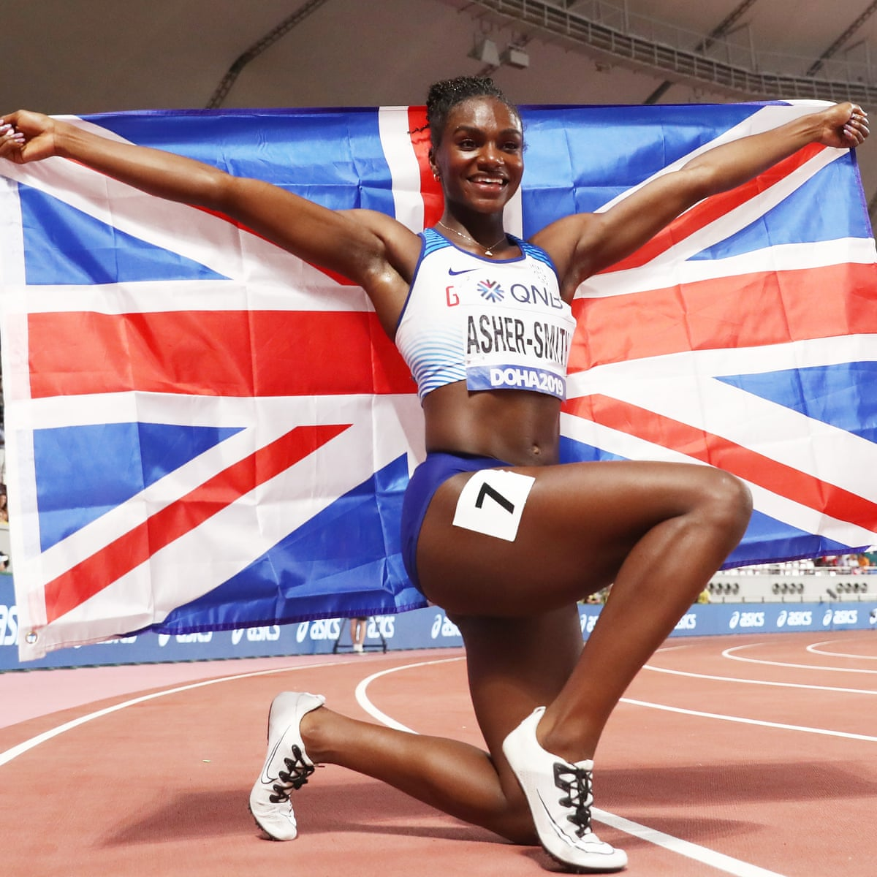
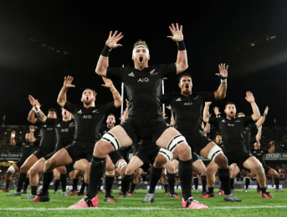
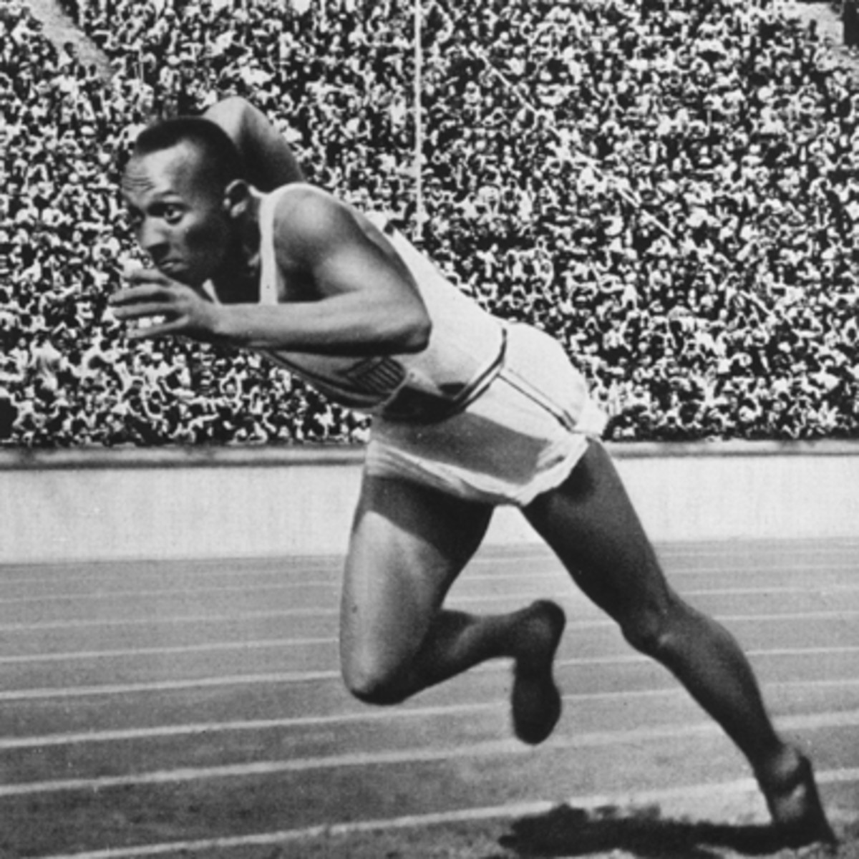
Physical Education
What can I read?
Exercised. The Science of Physical Activity, Rest and Health (Daniel Lieberman)
Pep Guardiola The Evolution (Marti Perarnau)
Relentless Secrets Of The Sporting Elite (Alistair Brownlee)
What can I watch?
Icarus (Netflix)
All or Nothing – New Zealand All Blacks (Amazon Prime)
Cool Runnings (Disney+)
Invictus (youtube)
Grid Iron (Amazon Prime)
Pho3nix SUB7 SUB8, Powered by Zwift (Youtube)
Where can I go?
There are numerous sports venues in England that host live sporting events throughout the year. (Villa Park, Ludlow Race Course, Alexander Stadium & The Belfry are some of the more local ones)
Museums and places of interest:
National Football Museum (Manchester)
Wimbledon Museum (London)
The Olympic Park (London)
Stadium Tours (Various)

