Slide 1
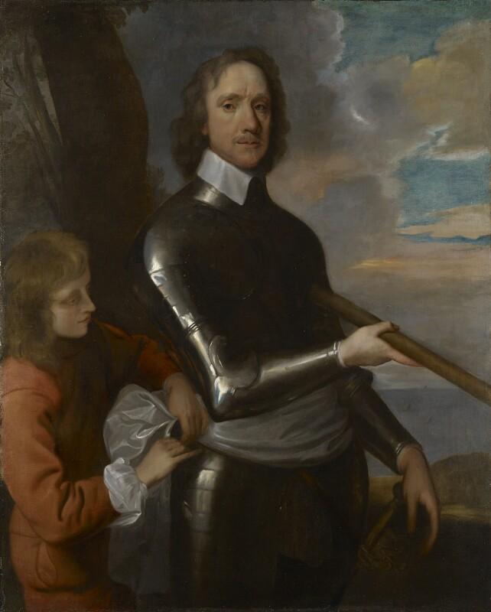
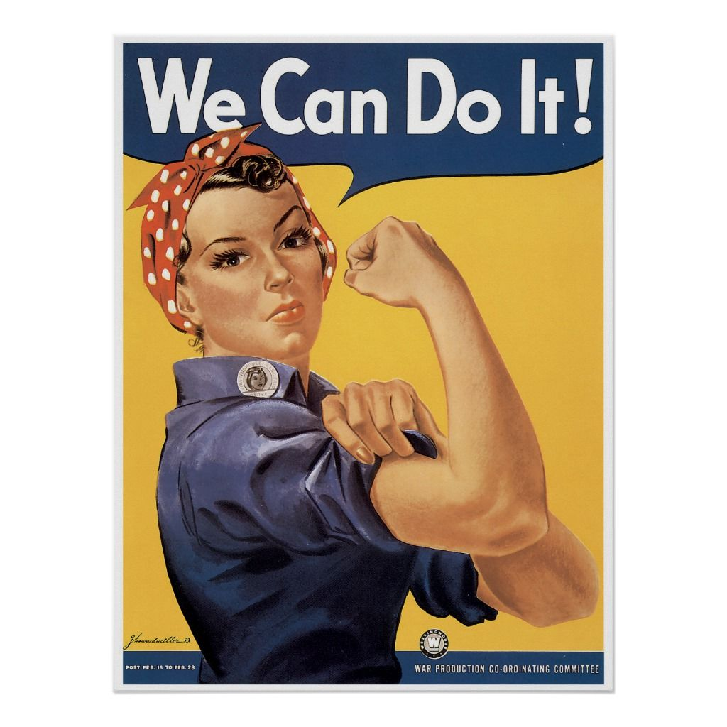
HISTORY
What can I read?
A Short History of the Vietnam War by Gordon Kerr
Oliver Twist by Charles Dickens
The First World War, A. J. P. Taylor
Death in Venice, Thomas Mann
Renaissance Town by Jacqueline Morley
The Horrible, Miserable and Middle Ages: The Disgusting Details About Life During Medieval Times by Kathy Allen
What can I watch?
Please be mindful that some of these films are rated 15
Victoria and Abdul (2017)
Sherlock Holmes (2009) Age rating 12A
Elizabeth: a golden Age
Good Morning, Vietnam (1987)
1917 (certificate 15)
War Horse
Thirteen days
Bridge of Spies
Where can I visit?
Imperial War Museum
British Museum
Worcester George Marshall Museum
Black Country Living Museum

