Slide 1
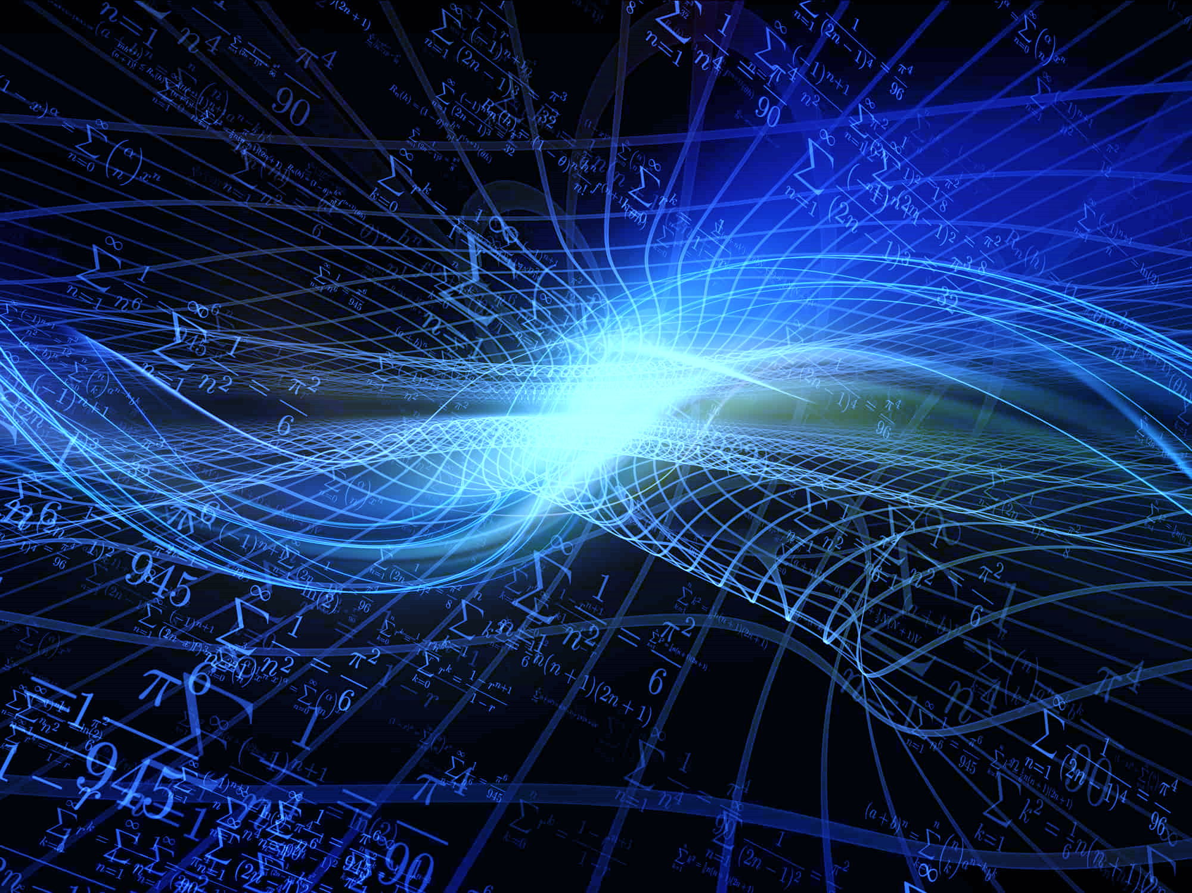
Things to Read
A brief history of time by Stephen Hawking
The Feynman Lectures on Physics
by Richard P. Feynman
Astrophysics for People in a Hurry by Neil deGrasse Tyson
The First Three Minutes by Steven Weinberg
PHYSICS
Where to go
Science museum – London
Thinktank – Birmingham
Kennedy space centre – Florida, US
RAF museum - London
Things to watch
Chernobyl
The Theory of Everything
Interstellar
Contact
Apollo 13

